Slide 1
SYMBIOSIS INSTITUTE OF TECHNOLOGY, HYDERABAD
SUBJECT: DATA STRUCTURES - LAB
LAB PROJECT PRESENTATION
Soul Gamble: The D'Arby Showdown
Data-Structure Driven Psychological Poker & Stand Showdown Simulator
SUBMITTED BY
BRANCH & PRN
PROJECT GUIDE
Divyansh Motwani
CSE | 25070721015
Dr. Rakesh Salakapuri

Slide 2

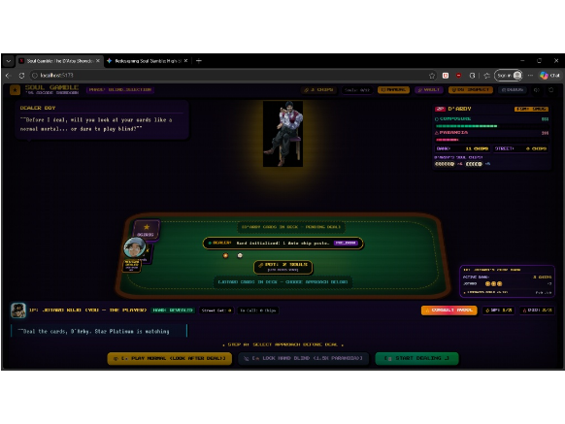
01 / ABSTRACT & INTRODUCTION
Project Overview & Core Vision
Soul Gamble replaces static randomized card arrays with transparent data structures in a 90s arcade poker showdown.
•
FPV Arcade Table: 3D 5-Card Draw Poker perspective.
•
Deque Card Shoe: Simulates top and bottom dealing.
•
LIFO Soul Pot: Manages bidirectional chip wagers.
•
Cognitive AI Engine: Tracks inverse Composure and Paranoia.

Slide 3



02 / SYSTEM ARCHITECTURE
Four Core Data Structures
Double-Ended Queue
LIFO Soul Stack
Frequency Hash Map
Finite State Machine
Constant-time dual-end card extraction.
Last-in first-out pot resolution.
Linear-time five-card hand classification.
Five-node opponent behavior engine.

Slide 4
03 / DOUBLE-ENDED QUEUE (DEQUE)
Deque Deck & Sleight-of-Hand
Deque.popFront()
Deque.extractSecond()
Deque.popBack()
Fair Top Deal
Second-Deal Cheat
Bottom-Deal Cheat
•
Target Node: Extracts index 0 head card.
•
Target Node: Retains index 0 top card.
•
Target Node: Extracts stacked tail card.
•
Complexity: Strict O(1) front removal.
•
Advantage: Deals index 1 to Jotaro.
•
Complexity: Strict O(1) rear removal.
•
Enforcer: Permanent Neutral Dealer Boy.
•
Detection: Caught via Star Platinum QTE.
•
Counterplay: Swapped via Deck Tamper.

Slide 5
04 / CHRONOLOGICAL DEAL & KINETIC VISION
5-Second Deal & QTE Pipeline
01
02
03
04
Pre-Deal Setup
5.0s Deal Window
Precision QTE Bar
Expose or Pocket
Lock blind hand for 1.5x paranoia.
Trigger Star Platinum via Spacebar.
Stop moving needle inside target zone.
Station Dealer Boy or tamper deck.

Slide 6

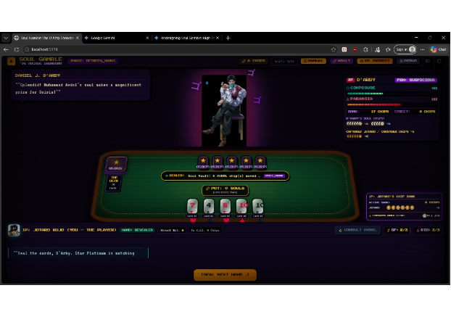
05 / LIFO STACK & TOKEN ACCOUNTING
Bidirectional LIFO Chip Economy
•
LIFO Pot Push: Every bet pushes owner-tagged tokens.
•
Liberated Vault: Locks won Joseph and Polnareff souls.
•
Captured Chips: D'Arby claims lost Crusader chips.
•
LIFO Re-Wager: D'Arby bets captured chips first.

Slide 7
06 / COLLATERAL ESCALATION RULES
Tiered Soul Vault Escalation
TIER 01 • 6 CHIPS
TIER 02 • 6 CHIPS
TIER 03 • LAST RESORT
Muhammad Avdol
Noriaki Kakyoin
Holly Kujo
+12% Paranoia boost upon bank reload.
+18% Paranoia boost for cold resolve.
+30% Paranoia final lifeline unlock.

Slide 8
07 / ALGORITHMIC SHOWDOWN ENGINE
Hash-Map Hand Evaluation
O(N)
52
9
Single-Pass Hand Evaluation
Indexed Deque Card Nodes
Classified Poker Hand Tiers
RankMap[rank]++ & SuitMap[suit]++ → Post-Draw Check or Call flips all 5 D'Arby cards for instant comparison.

Slide 9
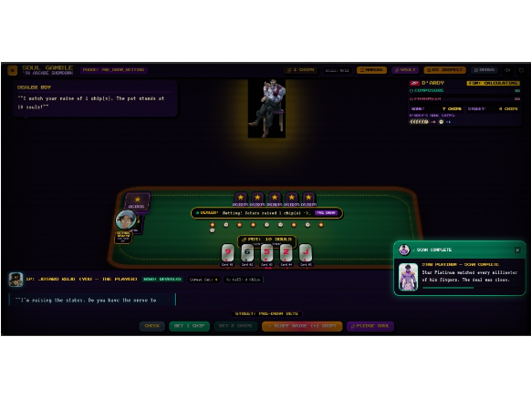
08 / IMPERFECT-INFORMATION GAME THEORY
Imperfect-Information Tells
•
0 Cards Drawn: Signals pat hand or bluff.
•
1 Card Drawn: Signals Two Pair or draw.
•
2 Cards Drawn: Signals Three of a Kind.
•
3 Cards Drawn: Signals One Pair holding.
•
Inverse Lock: Composure plus Paranoia equals 100%.

Slide 10
09 / FINITE STATE MACHINE (FSM)
FSM Behavioral Transition Matrix
FSM State | Inverse Threshold (C + P = 100%) | Raise / Bluff | Call / Check | Fold / Forfeit
SMUG (Default) | 10% ≤ P < 30% | 70% < C ≤ 90% | 0.65 (65%) | 0.30 (30%) | 0.05 (5%)
CALCULATING | 30% ≤ P < 60% | 40% < C ≤ 70% | 0.35 (35%) | 0.50 (50%) | 0.15 (15%)
PARANOID | 60% ≤ P < 100% | 0% < C ≤ 40% | 0.15 (15%) | 0.45 (45%) | 0.40 (40%)
CATATONIC | P = 100% | C = 0% (Breakdown) | 0.00 (0%) | 0.00 (0%) | 1.00 (100% Win)

Slide 11
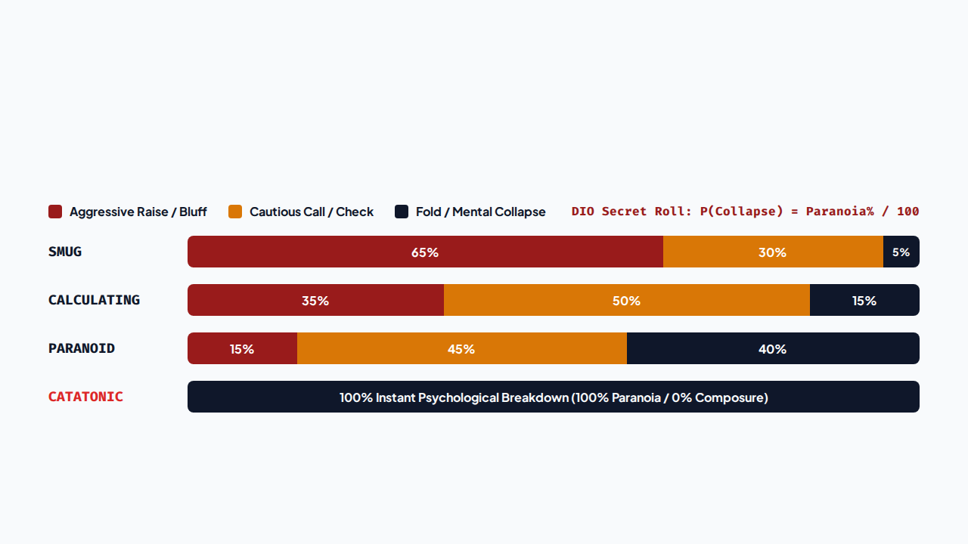
10 / BEHAVIORAL TELEMETRY & DIO GAMBIT
FSM Action Probability Distribution

Slide 12
APPLICATIONS & FUTURE SCOPE
Thank You & Questions
Future expansions include WebSocket multiplayer showdowns, Monte Carlo Tree Search (MCTS) lookahead, and Binary Search Tree Stand battles.
Divyansh Motwani • CSE • PRN: 25070721015 • SIT Hyderabad

